Slide 1
Supply
And equilibrium pricing

Slide 2
Law of Supply
As the price rises for a good, the quantity supplied generally rises.
As the price falls, the quantity supplied also falls.
The relationship between price and quantity supplied is direct (unlike the law of demand which is….)

Slide 3
Determinants of Supply
Change in the price of inputs
Change in number of firms providing the good
Change in taxes
Change in technology

Slide 4
Putting Supply & Demand Together
-Equilibrium price: quantity supplied by sellers is the same as the quantity demanded by buyers.
Shortages: demand is greater than quantity supplied
Surpluses: quantity supplied is greater than demand

Slide 5
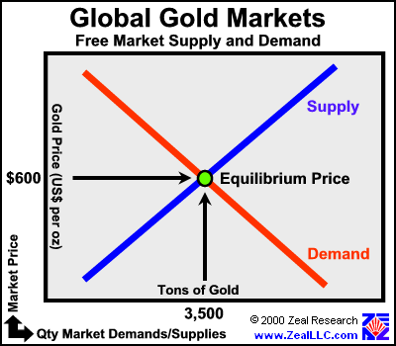
Equilibrium Curve

Slide 6
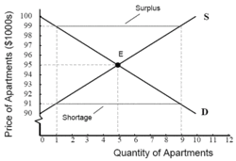
Surpluses and Shortages

Slide 7
Market Forces
If the market is left alone (no government intervention), then market forces will eliminate surpluses and shortages
The market takes care of itself

Slide 8
Price ceilings and floors
Price ceiling - A government-set maximum price that can legally be charged
Causes shortages, leading to a black market
Ex: rent controlled apartments
Price floor - A government-set minimum price
Can cause surpluses
Ex: minimum wage law

