Slide 1
Adam Smith, Trade-offs, and Opportunity costs

Slide 2
Adam Smith
Known as the “Father of Economics”
Wrote a book titled “Inquiry into the Wealth and Causes of Nations.”
Believed in a laissez-faire government/economy
Literally translates into “hands-off”. Government and economy are separate!

Slide 3
Trade-offs
Choices made by individuals, businesses, governments.
When a choice is made, something is given up, resulting in a trade-off.

Slide 4
Think of this situation: In the United States, children are legally required to attend school. Think of two examples of trade-offs made by any of the following: individuals, businesses, society because of the education law.

Slide 5
Opportunity Costs
The value of the NEXT best alternative after the chosen alternative.
What you would have chosen if you didn’t take your first choice.
Example: You have $20 to spend @ Target. You have to decide between a CD, DVD, or a shirt. You choose the CD. Your next choice would be the DVD, therefore that is your opportunity cost.

Slide 6
Production Possibilities Curve
Shows the maximum combinations of goods and services that can be produced within a given amount of resources.
Helps determine how much of each item to produce, revealing the trade-offs and opportunity costs involved.

Slide 7
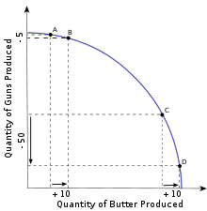
Example Guns v. Butter

